Slide 1
An Application of AI in Polyethylene Production Plants
Rafael Abbariao
Kerlos Saad
Meir Weiner
Karim Zaky
The Grove School of Engineering
The City College of New York

Slide 2
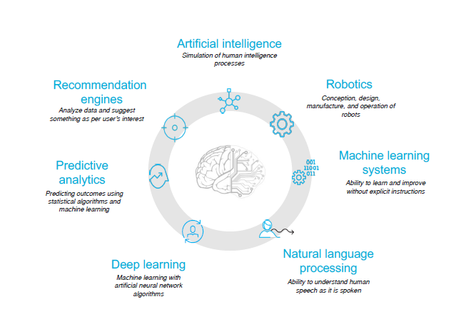
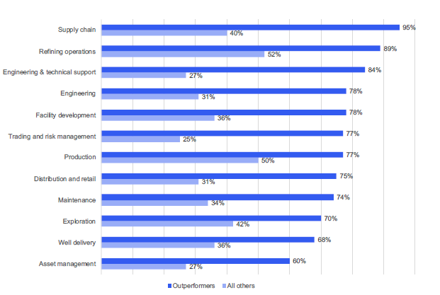
AI comprises various technologies and can be utilized to improve many business functions
Benefits of AI
Source: IBM Institute for Business Value, “IBM Petroleum Digital
Transformation Study”, 2017
Notes:
The percentages on the figure on the right depicts how much of that business sector has been digitized
Outperformers see value in and apply cognitive solutions to these sectors that…
Improve asset productivity
recruiting , retaining, and training talent
Invest in innovation and R&D
Capture real-time, accurate performance and maintenance data at the point of occurence
Control costs
Monitor remediating health, safety, and environmental risks
Find new sources of energy
Allow them to become more customer centric
Pursues mergers, acquisitions, divestitures
Address competition from new technologies
We can see that what separates the outperformers from the other companies are that more of their business functions have been digitized shows that there is reason to adopt AI since it improves performance

Slide 3
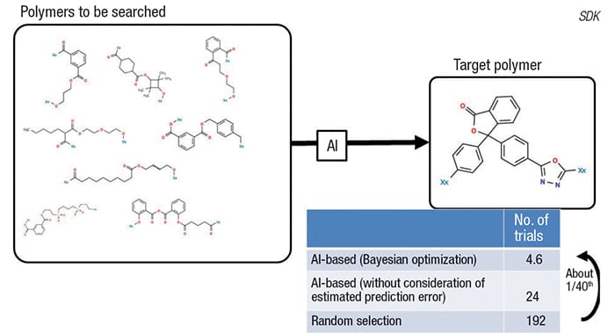
Current Applications of AI in the Industry
In the Materials Industry...
- A Japanese research project has applied AI to significantly expedite polymer design and accelerate the development of advanced functional materials.
- The AI-aided polymer design is about 40 times faster than conventional approaches.
- The technology can predict polymer properties in less than one second per polymer (Showa Denko K.K.)
https://www.chemengonline.com/artificial-intelligence-new-reality-chemical-engineers/

Slide 4
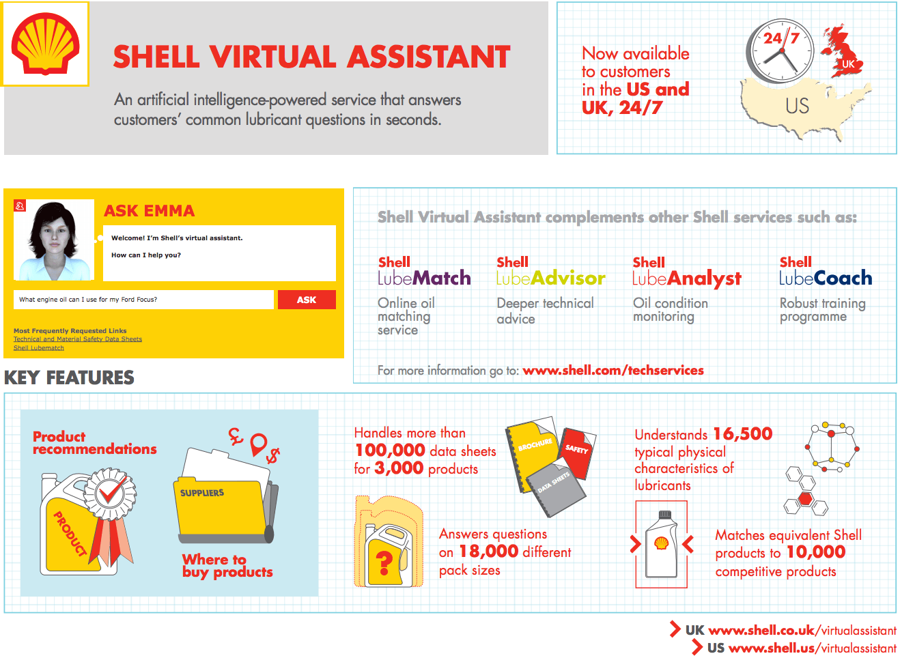
Current Applications of AI in the Industry
In the Petroleum Industry...
Shell Virtual Assistant:
In August 2015, Shell announced that it would be the first company in the lubricants sector to launch an AI assistant for customers
Handles 100,000 data sheets for 3000 products
Provides info on 18,000 different pack sizes
Understands 16,500 physical characteristics of lubricants
Matches Shell products to 10,000 competitive products
Plans to integrate virtual assistant called Amelia to its business model respond to supplier inquiries regarding invoicing more efficiently
https://emerj.com/ai-sector-overviews/artificial-intelligence-in-oil-and-gas/

Slide 5
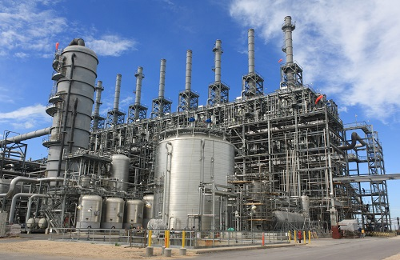
Case Study
Scenario:
Suppose that a new industrial facility plant is being constructed for polyethylene production. The manufacturing company turns to an Engineering, Procurement, Construction (EPC) company to help them develop the polyethylene plant.
User:
The engineering team is in the early stage of design and must quickly come up with specifications to safely operate the polyethylene plant. The Project Manager Consultant (PMC) needs to consider regulatory compliance in the process design of the polyethylene plant. The PMC is interested in knowing where to build safety showers given the operating units and chemical compounds that will be used to synthesize polyethylene.

Slide 6
Case Study
Scenario:
Suppose that a new industrial facility plant is being constructed for polyethylene production. The manufacturing company turns to an Engineering, Procurement, Construction (EPC) company to help them develop the polyethylene plant.
User:
The engineering team is in the early stage of design and must quickly come up with specifications to safely operate the polyethylene plant. The Project Manager Consultant (PMC) needs to consider regulatory compliance in the process design of the polyethylene plant. The PMC is interested in knowing where to build safety showers given the operating units and chemical compounds that will be used to synthesize polyethylene.

Slide 7
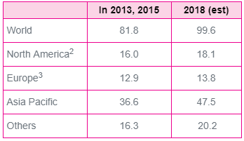

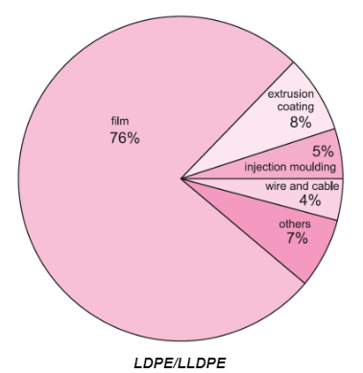
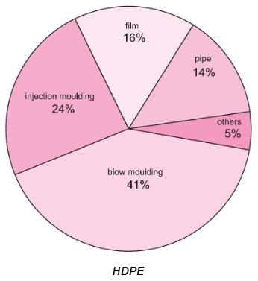
What is polyethylene?
Poly(ethene) or Polyethylene is a family of resins made from the polymerization of ethylene gas and at a global production of more than 100 millions tonnes, it is the most demanded plastic.
PE resins are classified by density
- HDPE: High Density PolyEthylene has near to no branching and stronger intermolecular forces
- LDPE: Low Density PolyEthylene has random long branching with branches on branches
- LLDPE: Linear Low Density PolyEthylene has linear shape with significant short branches
→ Result of the process and the chosen operating conditions!
http://www.essentialchemicalindustry.org/polymers/polyethene.html
Notes:
Global Demand for Polyethylene in million tonnes
The global polyethylene market was last valued at $164 billion and is projected to reach $190 billion by 2022 --> Higher demand met by erection of more PE plants

Slide 8
What is polyethylene?
Poly(ethene) or Polyethylene is a family of resins made from the polymerization of ethylene gas and at a global production of more than 100 millions tonnes, it is the most demanded plastic.
PE resins are classified by density
- HDPE: High Density PolyEthylene has near to no branching and stronger intermolecular forces
- LDPE: Low Density PolyEthylene has random long branching with branches on branches
- LLDPE: Linear Low Density PolyEthylene has linear shape with significant short branches
→ Result of the process and the chosen operating conditions!
http://www.essentialchemicalindustry.org/polymers/polyethene.html
Notes:
Global Demand for Polyethylene in million tonnes
The global polyethylene market was last valued at $164 billion and is projected to reach $190 billion by 2022 --> Higher demand met by erection of more PE plants

Slide 9
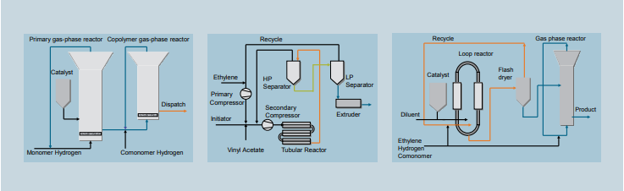
Polyethylene Production Process
General PE Production Process underpinned by 3 polymerization processes (from left to right):
- Gas-phase polymerization
- High-pressure/
Low-Pressure processes
- Liquid-phase polymerization
Notes:
In gas-phase polymerization the ethylene is contacted with solid catalyst material intimately dispersed in an agitated bed of dry polymer powder. Two different methods are used to carry out this reaction
In liquid-phase processes (slurry or suspension) catalyst and polymer particles are suspended in an inert solvent, typically a light or heavy hydrocarbon.
In high pressure processes autoclave or tubular reactors (pressure in excess of 3,000 bar) are used, but the processes are similar, comprising compression, polymerization, pelletizing, and dispatch as major steps. Fresh ethylene enters the reactor and is mixed with the low pressure recycle. After further compression the mixture enters the reactor for polymerization. Oxygen or peroxide may be used as initiators. A tubular reactor typically consists of several hundred meters of jacketed highpressure tubing arranged as a series of straight sections connected by 180° bends. High pressure processes can produce LLDPE homopolymers and vinyl acetate copoymers in addition to the normal range of LDPEs.
Pressure processes which are categorized into the high pressure or a low pressure process

Slide 10
Polyethylene Production Process
General PE Production Process underpinned by 3 polymerization processes (from left to right):
- Gas-phase polymerization
- High-pressure/
Low-Pressure processes
- Liquid-phase polymerization
Notes:
High pressure comprises of compression, polymerization, pelletizing and dispatch

Slide 11
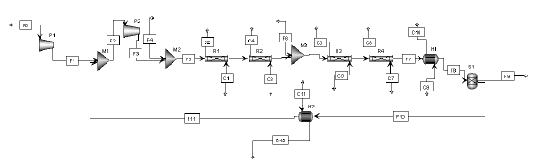
Polyethylene Production Process
General PE Production Process underpinned by 3 polymerization processes (from left to right):
- Gas-phase polymerization
- High-pressure/
Low-Pressure processes
- Liquid-phase polymerization

Slide 12
Polyethylene Production Process
General PE Production Process underpinned by 3 polymerization processes (from left to right):
- Gas-phase polymerization
- High-pressure/
Low-Pressure processes
- Liquid-phase polymerization
Initial compression of ethylene feed at 1500 bar

Slide 13
Polyethylene Production Process
General PE Production Process underpinned by 3 polymerization processes (from left to right):
- Gas-phase polymerization
- High-pressure/
Low-Pressure processes
- Liquid-phase polymerization
Initial compression of ethylene feed at 1500 bar followed by…
Further compression to compensate for pressure loss in recycle stream at 2000 bar

Slide 14
Polyethylene Production Process
General PE Production Process underpinned by 3 polymerization processes (from left to right):
- Gas-phase polymerization
- High-pressure/
Low-Pressure processes
- Liquid-phase polymerization
Autoclave or tubular reactors wherein polymerization occurs can be operated in excess pressures of 3000 bar

Slide 15


Polyethylene Production Process
A closer look at the reactors...
PE resins are classified by density
- HDPE: High Density PolyEthylene has near to no branching and stronger intermolecular forces
- LDPE: Low Density PolyEthylene has random long branching with branches on branches
- LLDPE: Linear Low Density PolyEthylene has linear shape with significant short branches
→ Result of the process and the chosen operating conditions!
Thus major safety concerns revolve around the plug flow reactor
- Polymerization is highly exothermic → Runaway reactions
- Reactor temperatures up to 300 bar
- Reactor pressures up to 3000 bar
- Component/Catalyst toxicology
Notes:
Runaway a result of failure in cooling system
THESE CONCERNS COULD HAVE GONE UNNOTICED DUE TO AN ENORMOUS AMOUNT OF DOCUMENTATION TO BE COVERED

Slide 16
Polyethylene Production Process
A closer look at the reactors...
PE resins are classified by density
- HDPE: High Density PolyEthylene has near to no branching and stronger intermolecular forces
- LDPE: Low Density PolyEthylene has random long branching with branches on branches
- LLDPE: Linear Low Density PolyEthylene has linear shape with significant short branches
→ Result of the process and the chosen operating conditions!
Thus major safety concerns revolve around the plug flow reactor
- Polymerization is highly exothermic → Runaway reactions
- Reactor temperatures up to 300 bar
- Reactor pressures up to 3000 bar
- Component/Catalyst toxicology
- *Less obvious, however, are emissions factors for volatile organic compounds as a result of the process
Notes:
Runaway a result of failure in cooling system
THESE CONCERNS COULD HAVE GONE UNNOTICED DUE TO AN ENORMOUS AMOUNT OF DOCUMENTATION TO BE COVERED
Engineering teams typically are good with numbers and operating conditions but often overlook the enforced constraints regarding the process → need to look into more documentation which would take more time

Slide 17
Polyethylene Production Process
A closer look...
PE resins are classified by density
- HDPE: High Density PolyEthylene has near to no branching and stronger intermolecular forces
- LDPE: Low Density PolyEthylene has random long branching with branches on branches
- LLDPE: Linear Low Density PolyEthylene has linear shape with significant short branches
→ Result of the process and the chosen operating conditions!
In other words…
NEED TO PRIORITIZE HEALTH, SAFETY, ENVIRONMENTAL (HSE) & REGULATORY COMPLIANCE!
Notes:
Runaway a result of failure in cooling system
Need to prioritize HSE and regulatory compliance to limit risk of incidents and damages while increasing construction productivity of the user.

Slide 18
Case Study
Scenario:
Suppose that a new industrial facility plant is being constructed for polyethylene production. The manufacturing company turns to an Engineering, Procurement, Construction (EPC) company to help them develop the polyethylene plant.
User:
The engineering team is in the early stage of design and must quickly come up with specifications to safely operate the polyethylene plant. The Project Manager Consultant (PMC) needs to consider regulatory compliance in the process design of the polyethylene plant. The PMC is interested in knowing where to build safety showers given the operating units and chemical compounds that will be used to synthesize polyethylene.
Notes:
That is exactly why this case study revolves around a project manager’s need to consider regulatory compliance

Slide 19
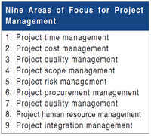
User Persona
- Project manager consultant Considers regulatory compliance in the process design of polyethylene plant - Engineering team In the early stage of design and must come up with specification to safety operate the polyethylene plant
- Third party companies Such as equipment suppliers that EPC companies will come in contact with them
Notes:
Project Manager - Typical functions include ensuring human and material resources, scope, cost, time, quality, communications and risk management align with the project demands

Slide 20
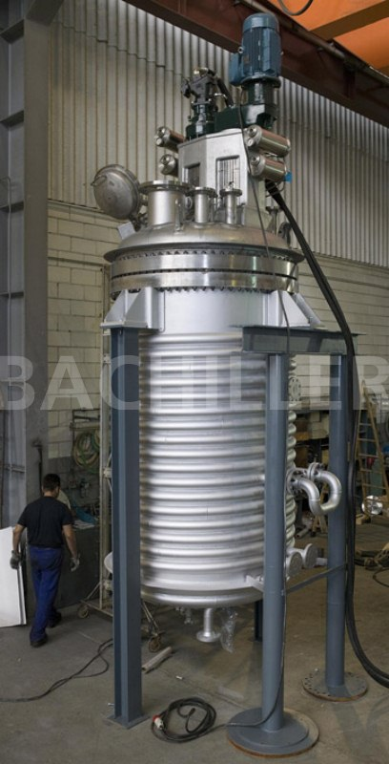
Need & Pain Points
- Growth of construction market. - Understanding technical specifications can be overwhelming. - Working around strict deadlines. - Intensive manual efforts to gather and research information. - Reading so much Information just to find a few bits of relevant data.
Example: An engineering team needs to find out what are the regulation on a specific pollutant in the exit stream of a polyethylene polymerization reactor.

Slide 21
AI Solution
Virtual assistant: - Can pull up information from regulation agencies (EPA, OSHA, ANSI). - Explore documents and unstructured data for specific info. - Trained to learn PE production process. - Ensures that polyethylene plant meets health, safety, and emissions regulations.

Slide 22
Benefits of User Solution
- Reduce time and effort in finding required data. - Spend more time in design. - Efficient project execution and alignment among team members. - Helps review standards compliance regulation within plants.

Slide 23
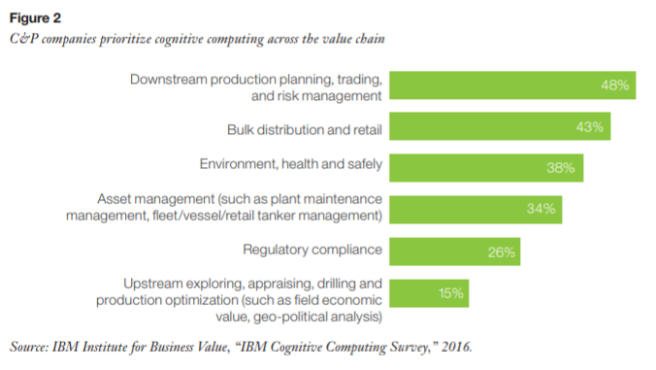
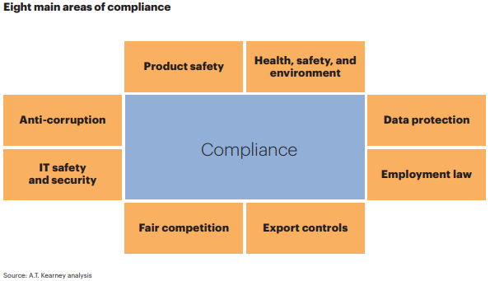
Benefits of AI
A complete AI instrument in the HSE field:
- Explore documents and unstructured text for
incident insights, using natural language
- Immediately locate similar incident reports based
on common themes and concepts
- Automatically find key items such as hazard
conditions, activities, incident causes and controls
- Uncover hidden trends in behaviors and
undetected hazards
- Reduce reliance on collective corporate memory
- Scale and augment HSE expertise
- Offer a new toolkit for OE improvement efforts
Notes:
In other words it would be able to sift through the dense documentation that revolves around compliance
Efficiency!!!!
In the field of compliance and HSSE (Health, Safety, Security and Environment), there are several pain points that hinder progress:
Stagnating or declining operational excellence performance metrics
Lost knowledge from workforce attrition
Limited sharing of incident information across sites
Lessons learned from past safety events are forgotten
Reinventing the wheel when taking actions to mitigate similar risks
Intensive manual effort to gather and research incident information, every time a hazard study is performed
Locating similar events within historical archives
Untapped knowledge buried in text or documents

Slide 24

Benefits of AI
Notes:
Refer to Scott Kimbleton’s Introductory Lecture
The point is not to eliminate the user experience but to increase user satisfaction and productivity.
The user is still in charge of ensuring that all necessary steps and documentation was taken with regards to the construction of the plant.
This does not alleviate risk mitigation measures and further maintenance as those roles aren’t immediately replaceable in high risk processes.

Slide 25
Our Solution
Implement AI solution intended to provide assistance regarding the technical specifications around a polyethylene plant and to efficiently provide the necessary documentation regarding control systems that ensure the plant adheres to HSE compliance.
Notes:
Control systems could comprise of:
Safety showers
Waste bins
Emission control of volatile organic compounds
unit specifications and conditions

Slide 26

Our AI solution
A safety and regulations virtual assistant in polyethylene plants.
The virtual assistant can answer general questions about:
Safety features and their regulations
Safety showers
Eye wash stations
Fume ventilations
Standards and general regulations
Work safety (OSHA)
Industry standards (ANSI)
Machine safety (HSE)
Emission control (EPA)
Polyethylene production
Low pressure polymerization process
High pressure polymerization process
Polyethylene applications.
Low Density Polyethylene (LDPE)
High Density Polyethylene (HDPE)
Linear Low Density Polyethylene (LLDPE)

Slide 27
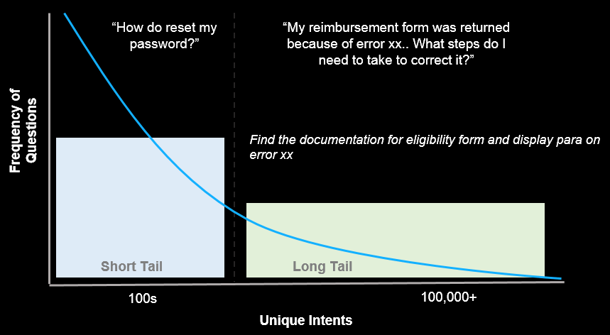
Short & Long Tail Questions:
Short tail questions examples:
Where do safety showers need to be installed in a polyethylene plant?
Are there any regulations in regards of eye wash stations?
I want to know about polyethylene applications.
Long tail questions examples:
How do I control emissions from a polymerization reactor?
What is maximum concentration of Volatile Organic Compound in a process vent

Slide 28
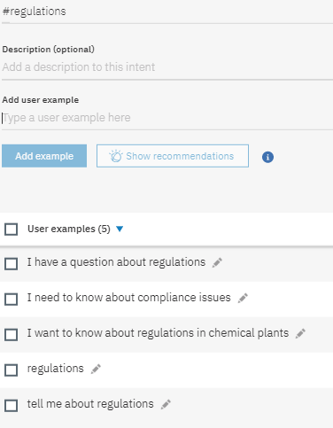
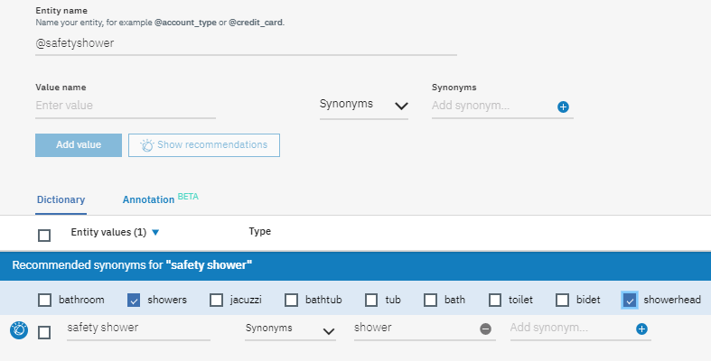
Watson Assistant
Intent: An intent is a purpose or goal expressed in a user’s input.
Some of the intents used in our PE advisor virtual assistant are:
#Regulations, #SafetyFeatures, #Applications ,#Production
Entity: An entity represents a class of objects or data type that is
relevant to a user’s purpose.
Some of the entities used in our virtual assistant are:
@SafetyShower, @ProcessUnit, @MachineSafety
Entity Example
Intent Example

Slide 29
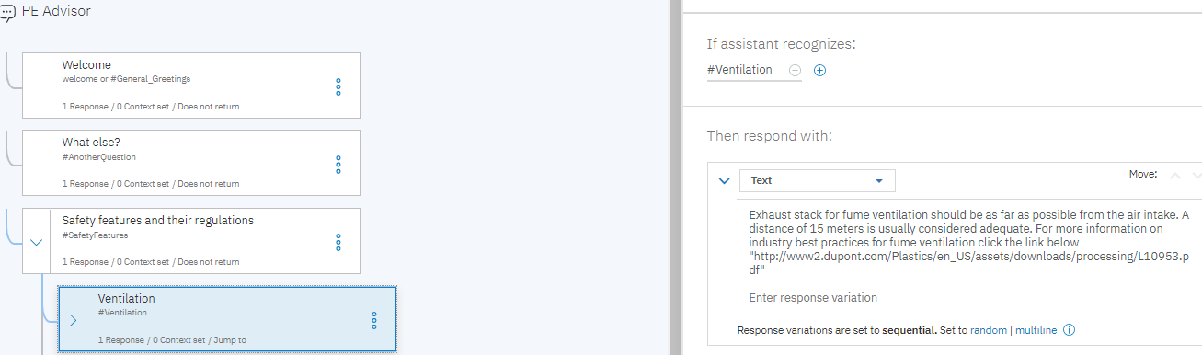
Watson Assistant: Dialogue Flow
Dialog: Dialog is the logical flow that determines responses when
the system considers any intents, entities or both
In a dialog, the virtual assistant provides responses based on conditions
Example:
A conditions: If the assistant recognizes the
intent #Ventilation (when already in the parent node of the intent #SafetyFeatures)
then provide the user with following predetermined response
Parent node
Child node

Slide 30
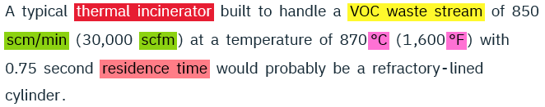
Watson Knowledge studio
WKS was used to train the documents and develop a machine learning model
The machine learning model is focused on EPA documents regarding emissions from polymer manufacturing plants
Entities were used to define concepts and objects in the documents
@Operting condition: Temperature, Pressure, Flow rate, Residence time
@Emission source: Process vent, waste stream, emission stream...
@Emmision control technique: flare, incineration...
@Flowrate: kg/hr, lb/hr, tons/year, scm/min, scfm
@Concentration: ppm, parts per million, weight percent...
Annotation Sample

Slide 31
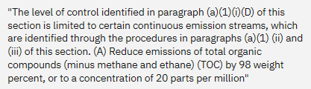
Watson Discovery
Discovery is used for running queries in a collection of relevant documents
A machine learning model was built in Watson Knowledge studio and deployed to discovery
Discovery is used when a long tail question is being asked by the user
The assistant will pass the question to discovery to run a query in the collection of documents and will find the most relevant answer based on a confidence score
Example:
What is the emission limit on the concentration of an exit stream ?
@Concentration
@Emission source
@Emission source
@Concentration

Slide 32
Node-RED
Node-RED is a programming tool for wiring together online services and APIs using a user friendly interface.
Using JavaScript (JS) I go through some testing to analyze the user’s question and the included entities or intent or both.
The user’s question would often be about an irrelevant topic. Using JS and Node-RED the chatbot will be able to realize that. The chatbot is interactive, it will notify the user of its abilities and the questions it could answer.
Watson Assistant is not capable of answering all questions. Using intents and entities identified the JS code will determine of this is a questions that should be answered by discovery.
To make the chatbot more interactive. Jump functions in Watson Assistant were utilized.
Jump functions are mimicked in JS using Node-RED to provide the Watson Tech Lead with the answers and flow provided on Bluemix Watson Assistant.
New lines are added to separate answers when more than one answer is provided to the user.

Slide 33
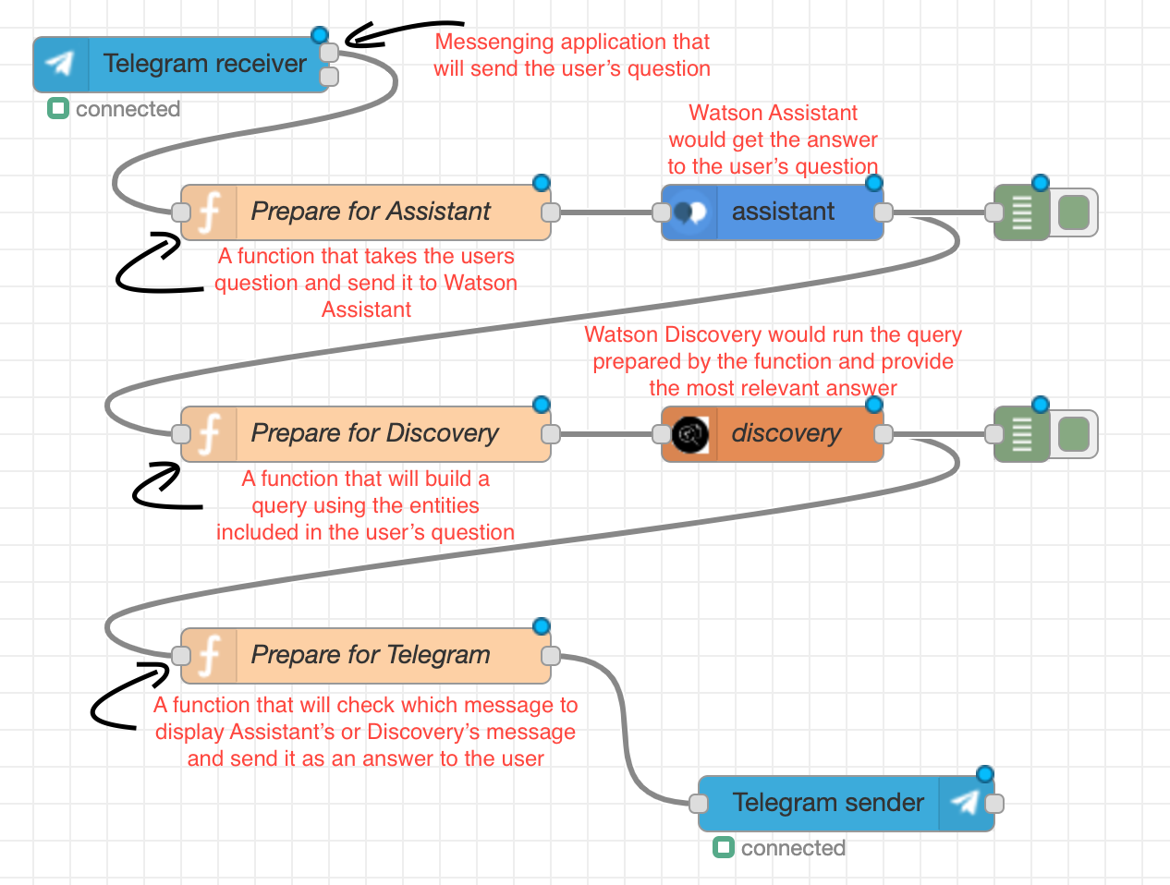
Node-RED

Slide 34
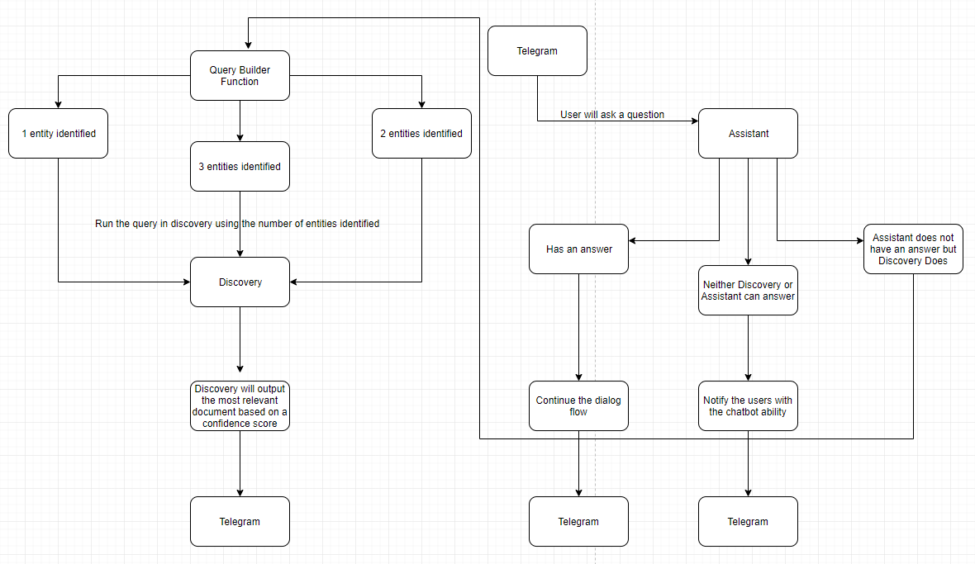
Process Flow Diagram

Slide 35
DEMO

